Slide 1
NSCC Accessibility Plan Evaluation Elaine da Silva (DA)

Slide 2

Rationale
Commitment to
Accessibility & Equity
This project aligns with NSCC’s commitment to equity, inclusion, and accessibility, recognizing accessibility as a social justice issue. By evaluating the 55 commitments in the NSCC Accessibility Plan, the institution ensures compliance with the Nova Scotia Accessibility Act and the Post-Secondary Accessibility Framework.

Slide 3
Nova Scotia Accessibility Act versus Post-Secondary Accessibility Framework
Nova Scotia Accessibility Act
Provincial legislation mandating a barrier-free Nova Scotia by 2030.
It applies to all sectors, including education, employment, transportation and the built environment.
It requires all post-secondary institutions to remove barriers.
Post-Secondary Accessibility Framework
A guide specifically for post-secondary institutions in Nova Scotia to help them comply with the Accessibility Act.
It focuses on equal access to education, policies and infrastructure in colleges and universities.
It helps institutions implement accessibility improvements in accordance with the mandates of the NS Act.

Slide 4

Goals
Goals | Expectations | Real outcomes
Evaluate the Accessibility Plan Performance | Measure the status of the 55 commitments in the NSCC Accessibility Plan (2022-2025) | Improved Accessibility Planning
Storytelling & Insights | Develop a narrative derived from the MS Forms submissions and the Survey results from the accessibility feedback process. | No structured or reliable data to tell a story.
Promote Institutional Transparency. | Communicate findings to stakeholders to ensure accountability. | Reporting on accessibility progress

Slide 5
Scope
In Scope | Out of Scope
Data Collection & Validation: gathering reports from department leads on accessibility initiatives and verifying their accuracy. | Creating new data sources: The project will use existing reports and stakeholder input but will not generate new data collection systems.
Data Analysis & Reporting: Analyzing qualitative and quantitative findings to identify gaps, success, and areas for improvement. | Implementing new accessibility measures: The project will provide recommendations, but actual changes will be planned and executed separately.
Final Report Submission: Delivering a structured performance report with findings, recommendations, and a roadmap for future accessibility improvements. | Decision-making on future accessibility plans: The project will provide insights and recommendations, but approval and execution of changes will be handled by NSCC leadership.

Slide 6
Deliverables
Deliverable | Description | Deadline
Project Charter | Create the project charter using the template provided. Formal document outlining the project’s goals, scope, stakeholders, and execution plan | Feb 7, 2025
Data Gather, Compilation and Analysis | Gather reports from department leads and validate data accuracy. Compiled and validated data on the 55 key commitments | Feb 14, 2025
Draft Report | Structured document outlining findings, trends, and recommendations. It includes the data from the spreadsheet and the surveys | Feb 21, 2025
Final Report | Approved and finalized version of the accessibility evaluation report and storytelling | Feb 28, 2025

Slide 7
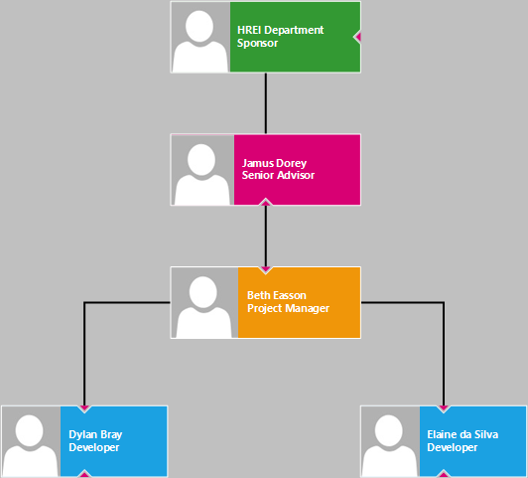
Team Structure
Project Role | Responsibilities | Assigned to
Project Sponsor | Ensures compliance with the Nova Scotia Accessibility Act, oversees resource allocation, and aligns accessibility initiatives with NSCC’s equity and inclusion strategies. | HREI - Human Rights, Equity, and Inclusion
Key Stakeholder | Provides strategic oversight, ensure alignment with NSCC’s accessibility and equity goals, and grant final approval on major deliverables and changes. | Jamus
Project Manager | Oversees project progress, manages stakeholders, and ensures goals are met. Also, facilitates communication between teams, support the development team, and ensure deliverables align with the project timeline and objectives. | Beth
Development Team | Performs technical work, including processing, analyzing, and organizing data from spreadsheets and surveys to generate insights to support decision-making. | Dylan, Elaine

Slide 8
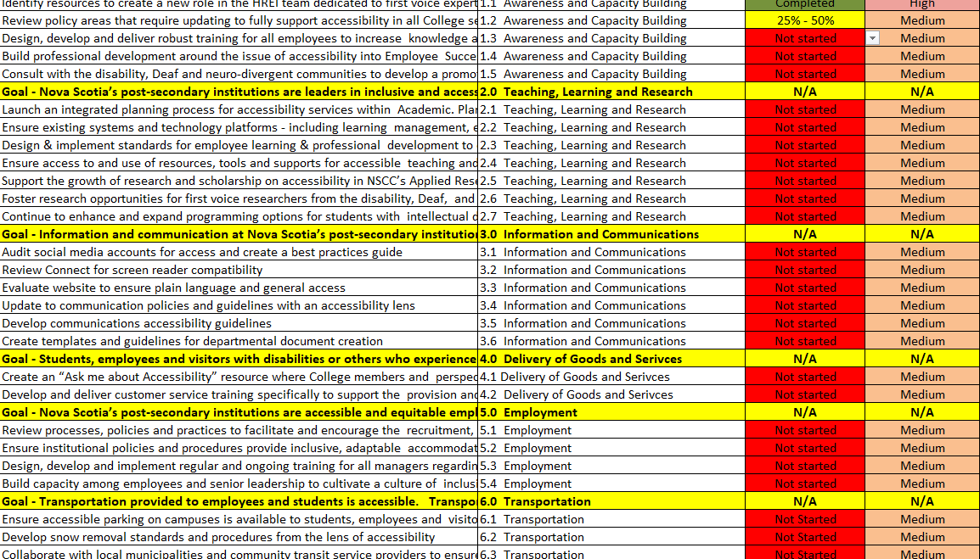
Datasources
Spreadsheet with the 55 commitments
Surveys and MS Forms results

Slide 9

Tools
TOOL | USED FOR
VISIO | Team structure and Schedule
EXCEL | Spreadsheet with 55 commitments
MS forms | Survey
Power BI Report | Visualization and Insights

Slide 10
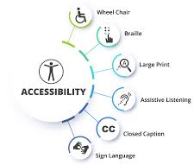
KPI: Accessibility Plan Adherence
How well the NSCC Accessibility Plan is being implemented based on the 55 commitments and the 8 priority areas.
Formula: Example, 47/55*100 ➔ 85.45%
Goal: 85% or higher

Slide 11
Schedule
No. | Milestone | Completion Date
1 | Project Kickoff | Jan 31, 2025
2 | Project Charter | Feb 7, 2025
3 | Data Gather, Compilation and Analysis | Feb 14, 2025
4 | Draft Report | Feb 21, 2025
5 | Final Report | Feb 28, 2025

Slide 13
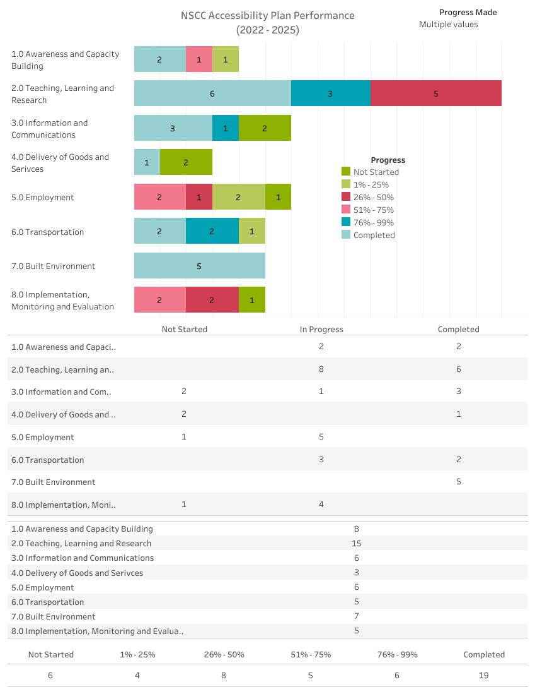
Tableau Dashboard

Slide 15
Thank you

